Slide 1
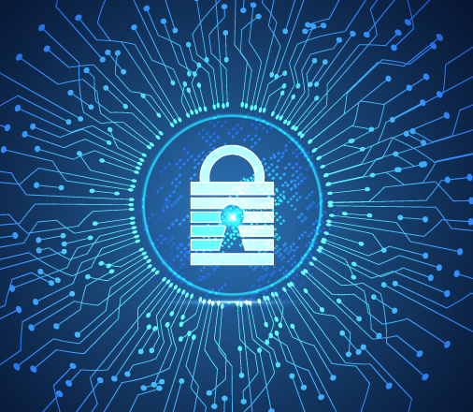
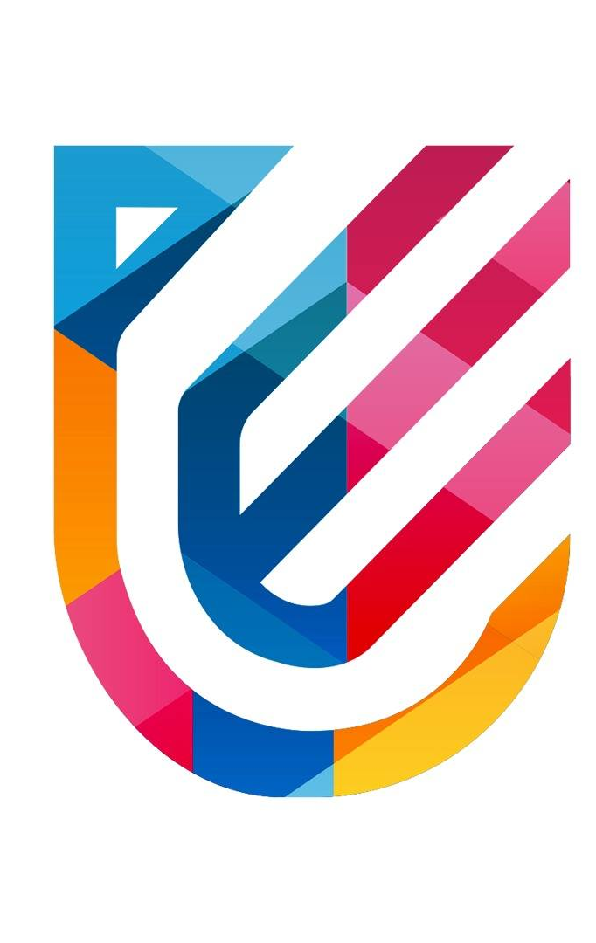
V Semester CSF
IT Data Security Lecture Series
Dr. Narendra Kumar Dewangan
Assistant Professor, Senior Scale
Systems, School of Computer Sciences
UPES Dehradun
Lecture-8

Slide 2
Benefits of data security and Data Security in Modern Era

Slide 3
Data Security in Modern Era
Key Modern Data Security Challenges
Increased Data Volume: The explosion of data from IoT, mobile devices, social media.
Cloud Security: Securing data in multi-cloud environments.
Remote Work: Increased vulnerability due to distributed workforces.
Sophisticated Threats: Use of AI by cybercriminals, state-sponsored attacks.

Slide 4
Core Data Security Principles (CIA Triad)
Confidentiality: Protecting data from unauthorized access.
Integrity: Ensuring data remains accurate and unaltered.
Availability: Ensuring authorized users can access data when needed.

Slide 5
Modern Data Security Technologies
Encryption: Secures data in transit and at rest.
Multi-Factor Authentication (MFA): Enhances access control.
Zero-Trust Architecture: Trust no one; verify everyone.
AI and Machine Learning: Detect anomalies and respond to threats.
Blockchain: Secure, decentralized data storage.

Slide 6
Regulatory Landscape
GDPR: General Data Protection Regulation (EU) – Protects personal data.
CCPA: California Consumer Privacy Act – US law on personal data protection.
HIPAA: Health Insurance Portability and Accountability Act – Medical data security.
ISO/IEC 27001: International standards for information security management systems.

Slide 7
Cloud and Data Security
Challenges in Cloud: Shared responsibility model, data sovereignty issues.
Solutions: Cloud encryption, Secure Access Service Edge (SASE), cloud security posture management (CSPM).

Slide 8
Trends in Data Security
Data Privacy: Growing importance of protecting personal data.
AI in Security: Predictive analytics for identifying threats.
Automation: Use of automated tools for vulnerability scanning, incident response.
Quantum Computing: Potential threat to encryption; development of quantum-resistant algorithms.

Slide 9
Strategies for Strengthening Data Security
Data Encryption: Encrypt sensitive data at rest and in transit.
Strong Access Controls: Use role-based access and MFA.
Regular Audits and Monitoring: Continuous monitoring for vulnerabilities.
Employee Training: Educate employees on data security practices.
Backup and Disaster Recovery: Ensure data can be recovered in case of loss or breach.

Slide 10
Future of Data Security
AI and Automation: Future tools for proactive threat detection.
Decentralization: Potential role of blockchain and decentralized systems.
Quantum-Resistant Cryptography: Preparing for the era of quantum computing.

Slide 11
Benefits of IT Data Security
1. Protection of Sensitive Data
Prevents Data Breaches: IT security helps in safeguarding personal, financial, and proprietary data from unauthorized access.
Avoids Data Theft: Protects against hackers and insider threats aiming to steal sensitive information.
2. Compliance with Regulations
Meeting Legal Requirements: Many industries are governed by strict data protection laws (e.g., GDPR, HIPAA). Strong IT security ensures compliance and avoids legal penalties.
Audits and Certifications: Enhanced security practices make passing security audits easier and help in obtaining certifications like ISO/IEC 27001.

Slide 12
Benefits of IT Data Security
3. Enhanced Business Reputation and Trust
Customer Trust: Companies that protect customer data effectively are more likely to earn and retain customer trust
Brand Reputation: Avoiding data breaches helps maintain a company’s good reputation, while breaches can severely damage public perception.
4. Minimized Financial Losses
Reduced Risk of Financial Damage: Data breaches and cyberattacks can result in hefty fines, legal costs, and business disruptions. IT security helps mitigate these risks.
Cost Savings: Preventing cyberattacks saves costs associated with data recovery, system repairs, and downtime.

Slide 13
Benefits of IT Data Security
5. Continuity of Business Operations
Prevents Downtime: Cyberattacks can lead to operational downtime, which is costly and disrupts business functions. IT security ensures systems stay functional and accessible.
Disaster Recovery: A strong security framework helps in quick recovery from attacks or other data loss incidents, ensuring minimal business disruption.
6. Safeguards Intellectual Property (IP)Protection of R&D and Innovation:
IT security protects intellectual property such as proprietary technologies, patents, and business strategies, which are critical to competitiveness.
Prevents Industrial Espionage: Companies can safeguard their innovations and trade secrets from being stolen by competitors or foreign entities.

Slide 14
Benefits of IT Data Security
7. Improved Employee Productivity
Fewer Interruptions: Security solutions such as malware protection reduce the number of successful cyberattacks, allowing employees to work without disruptions.
Safer Remote Work: Ensures secure access to company systems for remote employees, improving the flexibility and productivity of the workforce.
8. Risk Mitigation and Proactive Threat Detection
Early Threat Detection: Advanced IT security tools like AI-powered systems and continuous monitoring detect and prevent threats before they cause harm.
Reduced Risk of Insider Threats: Access control systems and monitoring ensure that unauthorized internal access is minimized.

Slide 15
Benefits of IT Data Security
9. Competitive Advantage
Differentiation in the Market: Companies with superior security protocols often stand out in industries where data protection is paramount, providing them with a competitive edge.
Increased Business Opportunities: Some clients, especially large enterprises or government organizations, require stringent data security measures before doing business.
10. Preserves Data Integrity and Availability
Ensures Data Accuracy: Security measures maintain data integrity by preventing unauthorized alterations.
Reliable Access: IT security ensures that authorized users can access the data they need, when they need it, without fear of system failures or breaches

Slide 16
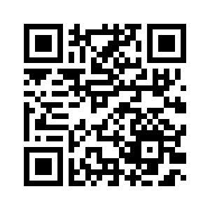
Thank You

